Slide 1
Problems in MAC

Slide 2
Formulas to Remember
Pure Aloha
Vulnerable Time = 2 Tfr Tfr is the frame transmission time
Time out time for acknowledgment Tb = 2 x Tp,
Exponential back off time Tb = R xTp, R = 0 to 2^{K}-1
Throughput = Gxe^{-2G}
Slotted Aloha
Vulnerable time = Tfr
Time out time for acknowledgment Tb = 2 x Tp,
Exponential back off time Tb = R xTp, R = 0 to 2^{K}-1
Throughput = Gxe^{-G}
Or
Throughput of aloha(slotted and Pure)= Efficiency x Bandwidth

Slide 3
The throughput for pure ALOHA is S = G × e ^{−2G} .
The maximum throughput
S_{max} = 0.184 when G= (1/2).
How to get 100% throughput?
Therefore, if a station generates only one frame in this vulnerable time (and no other stations generate a frame during this time), the frame will reach its destination successfully

Slide 4

Note
The throughput for slotted ALOHA is S = G × e^{−G} .
The maximum throughput S_{max} = 0.368 when G = 1.

Slide 5
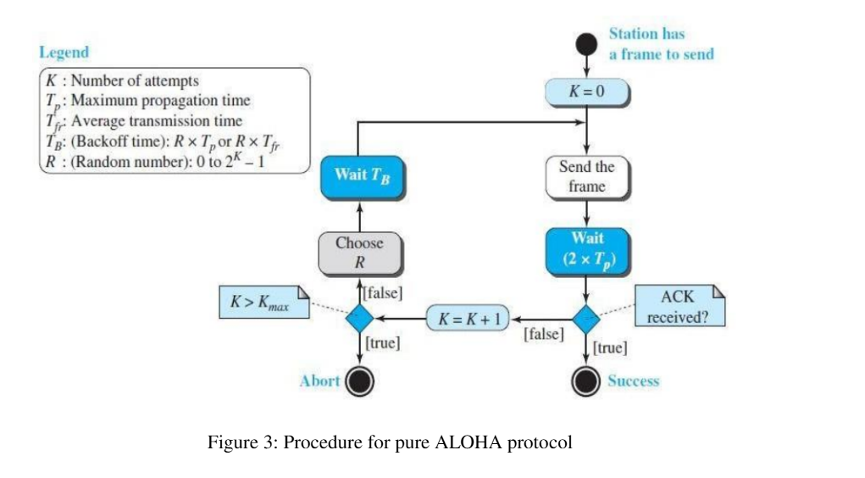

Slide 6
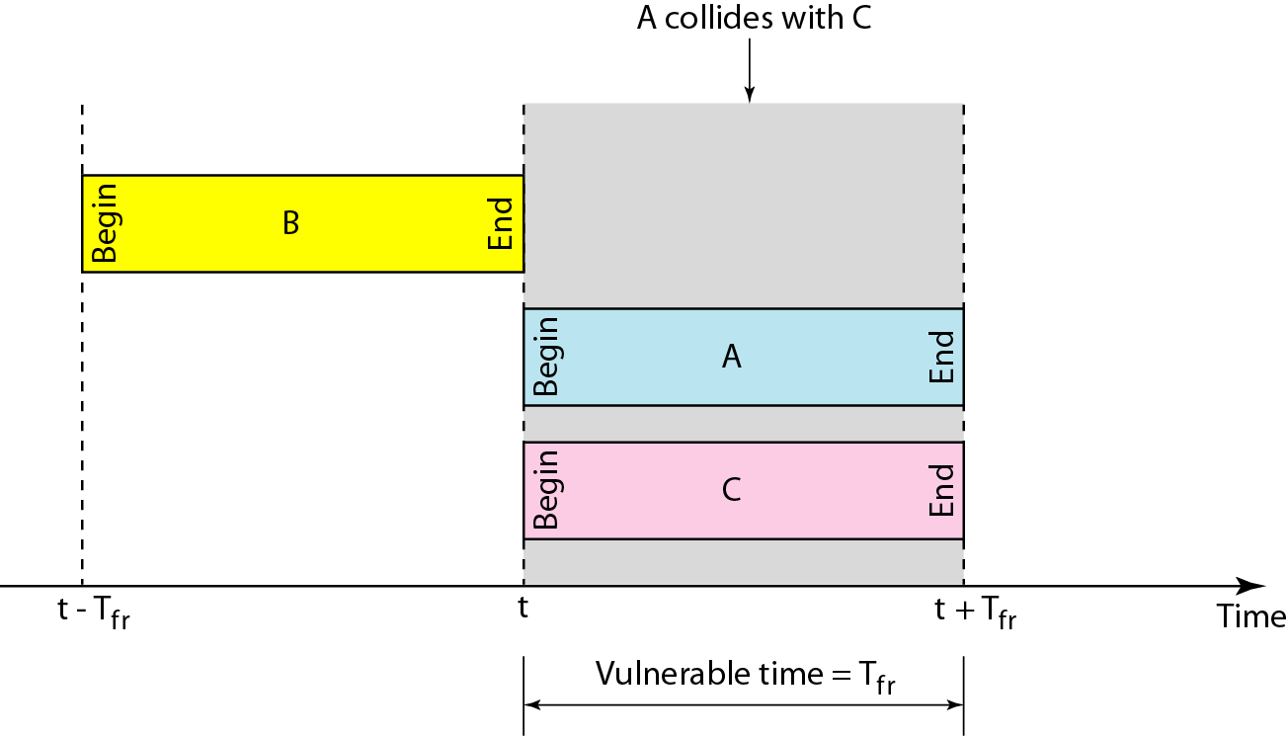
Figure 12.7 Vulnerable time for slotted ALOHA protocol

Slide 7
Example 1
The stations on a wireless ALOHA network are a maximum of 600 km apart. If we assume that signals propagate at 3 × 10⁸ m/s, we find
Tp = (600 × 10³ ) / (3 × 10⁸ ) = 2 ms.
find the value of T_{B} for different values of K .
R = 0 to 2^{K}-1 (K- No of Attempts, R- Random Number)
a. For K = 1, the range is {0, 1}. The station needs to| generate a random number with a value of 0 or 1. This means that T_{B} is either 0 ms (0 × 2) or 2 ms (1 × 2), based on the outcome of the random variable.

Slide 8
Example 12.1 (continued)
b. For K = 2, the range is {0, 1, 2, 3}. This means that T_{B} can be 0, 2, 4, or 6 ms, based on the outcome of the random variable.
c. For K = 3, the range is {0, 1, 2, 3, 4, 5, 6, 7}. This means that T_{B} can be 0, 2, 4, . . . , 14 ms, based on the outcome of the random variable.

Slide 9
Example 2
A pure ALOHA network transmits 200-bit frames on a shared channel of 200 kbps. What is the requirement to make this frame collision-free?
Solution
Average frame transmission time T_{fr} = 200 bits/200 kbps or
1 ms.
The vulnerable time is 2 × 1 ms = 2 ms.
This means no station should send later than 1 ms before this station starts transmission and no station should start sending during the one 1-ms period that this station is sending.

Slide 10
Example 3
A group of N stations share 100 Kbps slotted ALOHA channel. Each station output
a 500 bits frame on an average of 5000 ms even if previous one has not been sent. What is the required value of N?
Solution
Throughput Of One Station-
Throughput of each station
= Number of bits sent per second
= 500 bits / 5000 ms
= 500 bits / (5000 x 10⁻³ sec)
= 100 bits/sec
Throughput Of Slotted Aloha-
Throughput of slotted aloha
= Efficiency x Bandwidth
= 0.368 x 100 Kbps
= 36.8 Kbps

Slide 11
Example 3 continued…
Total Number Of Stations-
Throughput of slotted aloha = Total number of stations x Throughput of each station
Substituting the values, we get-
36.8 Kbps = N x 100 bits/sec
∴ N = 368
Thus, required value of N = 368.

Slide 12
Example 3a
A group of N stations shares a 56-kbps pure ALOHA channel. Each station outputs a 1000-bit frame on an average of once every 100 sec, even if the previous one has not yet been sent (e.g., the stations can buffer outgoing frames). What is the maximum value of N?
Solution
Throughput Of One Station-
Throughput of each station
= Number of bits sent per second
= 1000 bits / 100sec
= = 10 bits/sec
Throughput Of pure Aloha
= Efficiency x Bandwidth
= 0.18 x 56Kbps
= 10.3 Kbps

Slide 13
Example 3a continued…
Total Number Of Stations-
Throughput of pure aloha = Total number of stations x Throughput of each station
Substituting the values, we get-
10.3 Kbps = N x 10 bits/sec
∴ N =10300/10=1030 stations.
Thus, required value of N =1030

Slide 14
1000 airline reservation stations are competing for the use of a single slotted ALOHA channel. The average station makes 36 requests per hour. A slot is 100 µsec. What is the approximate total channel load?
Each terminal makes one request every
3600 sec / 36 request = 100 sec.
Total load is 1000 requests per 100 sec or 10 requests per sec.
There are
1 sec/100 µsec = 1000000 µsec / 100 µsec = 10000 slots in one second.
Hence, G=10/10000=1/1000=0.1%

Slide 15
Example 4
Let us call G the average number of frames generated by the system during one frame transmission time. Then it can be proved that the average number of successful transmissions for pure ALOHA is
S = G x e^{-2G}

Slide 16
Example 5
A pure ALOHA network transmits 200-bit frames on a shared channel of 200 kbps. What is the throughput if the system (all stations together) produces
a. 1000 frames per second b. 500 frames per second
c. 250 frames per second.
Solution
The frame transmission time is 200/200 kbps or 1 ms.
a. If the system creates 1000 frames per second, this is 1 frame per millisecond. The capacity is G 1. In this case S = G× e^{−2 G} = 1 x e -2 x 1 S = 0.135 (13.5 percent). This means that the throughput is 1000 × 0.135 = 135 frames. Only 135 frames out of 1000 will probably survive.

Slide 17
Example 5 (continued)
b. If the system creates 500 frames per second, this is (1/2) frame per millisecond. The load is (1/2). In this case S = G × e ^{−2G} or S = 0.184 (18.4 percent). This means that the throughput is 500 × 0.184 = 92 and that only 92 frames out of 500 will probably survive. Note that this is the maximum throughput case, percentagewise.
c. If the system creates 250 frames per second, this is (1/4) frame per millisecond. The load is (1/4). In this case S = G × e −^{2G} or S = 0.152 (15.2 percent). This means that the throughput is 250 × 0.152 = 38. Only 38 frames out of 250 will probably survive.

Slide 18
CSMA –CD
Propagation delay =Distance / Propagation speed
Minimum frame size = 2 x Propagation delay x Bandwidth
Or
Minimum frame size = Frame transmission time XBandwidth
Frame transmission time is t_{fr} = 2 × t_{p}
T_{p --}propagation delay

Slide 19
Example 8
In a CSMA / CD network running at 1 Gbps over 1 km cable with no repeaters, the signal speed in the cable is 200000 km/sec. What is minimum frame size?
Example 9
A and B are the only two stations on an Ethernet. Each has a steady queue of frames to send. Both A and B attempt to transmit a frame, collide, and A wins the first backoff race. At the end of this successful transmission by A, both A and B attempt to transmit and collide. The probability that A wins the second backoff race is:
Example 10
Suppose nodes A and B are on same 10 Mbps Ethernet segment and the propagation delay between two nodes is 225 bit times. Suppose A and B send frames at t=0, the frames collide then at what time, they finish transmitting a jam signal. Assume a 48 bit jam signal

Slide 20
Example 8
In a CSMA / CD network running at 1 Gbps over 1 km cable with no repeaters, the signal speed in the cable is 200000 km/sec. What is minimum frame size?
Solution
Propagation delay =Distance / Propagation speed - 1 km / (200000 km/sec) = 5 x 10⁻⁶ sec
Calculating Minimum Frame Size-
Minimum frame size = 2 x Propagation delay x Bandwidth
- 2 x 5 x 10⁻⁶ sec x 10⁹ bits per sec = 10000 bits

Slide 21
Example 10
Suppose nodes A and B are on same 10 Mbps Ethernet segment and the propagation delay between two nodes is 225 bit times. Suppose A and B send frames at t=0, the frames collide then at what time, they finish transmitting a jam signal. Assume a 48 bit jam signal

Slide 22
Example 10
. Solution-
Propagation delay (T_{p})
= 225 bit / 10 Mbps - 22.5 μsec
At t = 0,
Nodes A and B start transmitting their frame.
Since both the stations start simultaneously, so collision occurs at the mid way.
Time after which collision occurs = Half of propagation delay.
So, time after which collision occurs = 22.5 μsec / 2 = 11.25 μsec.
At t = 11.25 μsec,
After collision occurs at t = 11.25 μsec, collided signals start travelling back.
Collided signals reach the respective nodes after time = Half of propagation delay
Collided signals reach the respective nodes after time = 22.5 μsec / 2 = 11.25 μsec.
Thus, at t = 22.5 μsec, collided signals reach the respective nodes.
At t = 22.5 μsec,
As soon as nodes discover the collision, they immediately release the jam signal.
Time taken to finish transmitting the jam signal = 48 bit time = 48 bits/ 10 Mbps = 4.8 μsec.
Thus,
Time at which the jam signal is completely transmitted
= 22.5 μsec + 4.8 μsec
= 27.3 μsec or 273 bit times

Slide 23
Example 11
A network using CSMA/CD has a bandwidth of 10 Mbps. If the maximum propagation time (including the delays in the devices and ignoring the time needed to send a jamming signal, as we see later) is 25.6 μs, what is the minimum size of the frame?
Solution
The frame transmission time is T_{fr} = 2 × T_{p} = 51.2 μs.
This means, in the worst case, a station needs to transmit for a period of 51.2 μs to detect the collision.
The minimum size of the frame is 10 Mbps × 51.2 μs = 512 bits or 64 bytes.
This is actually the minimum size of the frame for Standard Ethernet.

Slide 24
Example 13
A 2 km long broadcast LAN has 10⁷ bps bandwidth and uses CSMA / CD. The signal travels along the wire at 2 x 10⁸ m/sec. What is the minimum frame size that can be used on this network?
Solution-
Given-
Distance = 2 km
Bandwidth = 10⁷ bps
Speed = 2 x 10⁸ m/sec

Slide 25
Calculating Propagation Delay-
Propagation delay (T_{p})
= Distance / Propagation speed
= 2 km / (2 x 10⁸ m/sec)
= 2 x 10³ m / (2 x 10⁸ m/sec)
= 10⁻⁵ sec
Calculating Minimum Frame Size-
Minimum frame size
= 2 x Propagation delay x Bandwidth
= 2 x 10⁻⁵ sec x 10⁷ bits per sec
= 200 bits or 25 bytes

Slide 26
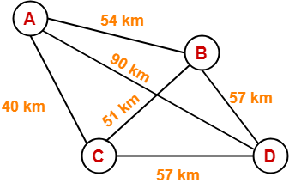
Example 14:
The network consists of 4 hosts distributed as shown below-

Slide 27
Assume this network uses CSMA / CD and signal travels with a speed of 3 x 10⁵ km/sec. If sender sends at 1 Mbps, what could be the minimum size of the packet?
Solution-
CSMA / CD is a Access Control Method.
It is used to provide the access to stations to a broadcast link.
In the given network, all the links are point to point.
So, there is actually no need of implementing CSMA / CD.
Stations can transmit whenever they want to transmit.
In CSMA / CD, The condition to detect collision is- Packet size >= 2 x (distance / speed) x Bandwidth

Slide 28
So, we use the values-
Distance = 90 km
Speed = 3 x 10⁵ km/sec
Bandwidth = 1 Mbps
Substituting these values, we get-
Minimum size of data packet
= 2 x (90 km / 3 x 10⁵ km per sec) x 1 Mbps
= 2 x 30 x 10⁻⁵ sec x 10⁶ bits per sec
= 600 bits

Slide 29
Example 15
Consider a LAN with average source and destination 100 meters apart and the round trip delay of 10 μs. At ______ data rate does the round trip delay equal to the transmission delay for 512 B packets
RTT = 10 * 10^6 s
Tt = L/B = 512 * 8 /B
Given RTT = Tt
B = 512 * 8 / 10 * 10^6
= 409.6 * 10^6 bits/s
= 410 Mbps

Slide 30
Example 16
After the k^{th} consecutive collision, each colliding station waits for a random time chosen from the interval-
(0 to 2^{k}) x RTT
(0 to 2^{k}-1) x RTT
(0 to 2^{k}-1) x Maximum Propagation delay
(0 to 2^{k-1}) x Maximum Propagation delay
Solution-
Clearly, Option (B) is correct.

Slide 31
A 1-km-long, 10-Mbps CSMA/CD (Carrier Sense Multiple Access with Collision Detection) LAN (not 802.3) has a propagation speed of 200 m/µsec. Repeaters are not allowed in this system. Data frames are 256 bits long, including 32 bits of header, checksum, and other overhead. The first bit slot after a successful transmission is reserved for the receiver to capture the channel in order to send a 32-bit acknowledgement frame. What is the effective data rate, excluding overhead, assuming that there are no collisions?
Solution
The round-trip propagation time of the cable is 10 µ sec . A complete transmission has six phases:
1) Transmitter seizes cable (10 µ sec )
2) Transmit data (25.6 µ sec )
3) Delay for last bit to get to the end (5.0 µ sec )
4) Receiver seizes cable (10 µ sec )
5) Acknowledgement sent (3.2 µ sec )
6) Delay for last bit to get to the end (5.0 µ sec )
The sum of these is 58.8 µ sec . In this period, 224 data bits are sent, for a rate of about
3.8 Mbps

Slide 32
Problem-04:
A and B are the only two stations on Ethernet. Each has a steady queue of frames to send. Both A and B attempts to transmit a frame, collide and A wins first back off race. At the end of this successful transmission by A, both A and B attempt to transmit and collide. The probability that A wins the second back off race is ___

Slide 33
Solution-
According to question, we have-
1st Transmission Attempt-
Both the stations A and B attempts to transmit a frame.
A collision occurs.
Back Off Algorithm runs.
Station A wins and successfully transmits its 1st data packet.
2nd Transmission Attempt-
Station A attempts to transmit its 2nd data packet.
Station B attempts to retransmit its 1st data packet.
A collision occurs.

Slide 34
Example 9
A and B are the only two stations on an Ethernet. Each has a steady queue of frames to send. Both A and B attempt to transmit a frame, collide, and A wins the first back off race. At the end of this successful transmission by A, both A and B attempt to transmit and collide. The probability that A wins the second back-off race is:
Qn2 – Ans
1st attempt: Value of ‘k’ would be k=0 or k=1 (0 <= k <= 2^n-1; where n=nth attempt). Since A won the first race, A must have chosen k=0 and B must have chosen k=1 (A wins here with probability 0.25). As A won, A will again choose k=0 or k=1 for its 2nd frame, but B will choose k=0,1,2 or 3 as B failed to send its first frame in the first attempt.
2nd attempt: Let kA= value of k chosen by A and kB = value of k chosen by B. We will use notation (kA, kB) to show the possible values. Now the sample space for the 2nd attempt is (kA, kB) = (0,0),(0,1),(0,2),(0,3),(1,0),(1,1),(1,2) or (1,3) i.e. 8 possible outcomes. For A to win, kA should be less than kB (kA < kB). Thus, our event space is (kA, kB) = (0,1),(0,2),(0,3),(1,2),(1,3) i.e. 5 possible outcomes.
Thus the probability that A wins the 2nd back-off race = 5/8 = 0.625

Slide 35
Now,
We have been asked the probability of station A to transmit its 2nd data packet successfully after 2nd collision.
After the 2nd collision occurs, we have-
At Station A-
2nd data packet of station A undergoes collision for the 1st time.
So, collision number for the 2nd data packet of station A = 1.
Now, station A randomly chooses a number from the range [0,2¹-1] = [0,1].
Then, station A waits for back off time and then attempts to retransmit its data packet.
At Station B-
1st data packet of station B undergoes collision for the 2nd time.
So, collision number for the 1st data packet of station B = 2.
Now, station B randomly chooses a number from the range [0,2²-1] = [0,3].
Then, station B waits for back off time and then attempts to retransmit its data packet.

Slide 36
Following 8 cases are possible- From here, Probability of A winning the 2nd back off race = 5 / 8 = 0.625
Station A | Station B | Remark
0 | 0 | Collision
0 | 1 | A wins
0 | 2 | A wins
0 | 3 | A wins
1 | 0 | B wins
1 | 1 | Collision
1 | 2 | A wins
1 | 3 | A wins

Slide 37
Problem-05:
Suppose nodes A and B are on same 10 Mbps Ethernet segment and the propagation delay between two nodes is 225 bit times. Suppose A and B send frames at t=0, the frames collide then at what time, they finish transmitting a jam signal. Assume a 48 bit jam signal.
Propagation delay (T_{p})
= 225 bit times
= 225 bit / 10 Mbps
= 22.5 x 10⁻⁶ sec
= 22.5 μsec

Slide 38
At t = 0,
Nodes A and B start transmitting their frame.
Since both the stations start simultaneously, so collision occurs at the mid way.
Time after which collision occurs = Half of propagation delay.
So, time after which collision occurs = 22.5 μsec / 2 = 11.25 μsec.
At t = 11.25 μsec,
After collision occurs at t = 11.25 μsec, collided signals start travelling back.
Collided signals reach the respective nodes after time = Half of propagation delay
Collided signals reach the respective nodes after time = 22.5 μsec / 2 = 11.25 μsec.
Thus, at t = 22.5 μsec, collided signals reach the respective nodes.
At t = 22.5 μsec,
As soon as nodes discover the collision, they immediately release the jam signal.
Time taken to finish transmitting the jam signal = 48 bit time = 48 bits/ 10 Mbps = 4.8 μsec.
Time at which the jam signal is completely transmitted
= 22.5 μsec + 4.8 μsec
= 27.3 μsec or 273 bit times

Slide 39
E
Suppose nodes A and B are attached to opposite ends of the cable with propagation delay of 12.5 ms. Both nodes attempt to transmit at t=0. Frames collide and after first collision, A draws k=0 and B draws k=1 in the exponential back off protocol. Ignore the jam signal. At what time (in seconds), is A’s packet completely delivered at B if bandwidth of the link is 10 Mbps and packet size is 1000 bits.
Solution-
Given-
Propagation delay = 12.5 ms
Bandwidth = 10 Mbps
Packet size = 1000 bits

Slide 40
Time At Which Collision Occurs-
Collision occurs at the mid way after time
= Half of Propagation delay
= 12.5 ms / 2
= 6.25 ms
Thus, collision occurs at time t = 6.25 ms.
Time At Which Collision is Discovered-
Collision is discovered in the time it takes the collided signals to reach the nodes
= Half of Propagation delay
= 12.5 ms / 2
= 6.25 ms
Thus, collision is discovered at time t = 6.25 ms + 6.25 ms = 12.5 ms.

Slide 41
Scene After Collision-
After the collision is discovered,
Both the nodes wait for some random back off time.
A chooses k=0 and then waits for back off time = 0 x 25 ms = 0 ms.
B chooses k=1 and then waits for back off time = 1 x 25 ms = 25 ms.
From here, A begins retransmission immediately while B waits for 25 ms.
Waiting Time For A-
After winning the back off race, node A gets the authority to retransmit immediately.
But node A does not retransmit immediately.
It waits for the channel to clear from the last bit aborted by it on discovering the collision.
Time taken by the last bit to get off the channel = Propagation delay = 12.5 ms.
So, node A waits for time = 12.5 ms and then starts the retransmission.
Thus, node A starts the retransmission at time t = 12.5 ms + 12.5 ms = 25 ms.
Time Taken in Delivering Packet To Node B-
Time taken to deliver the packet to node B
= Transmission delay + Propagation delay
= (1000 bits / 10 Mbps) + 12.5 ms
= 100 μs + 12.5 ms
= 0.1 ms + 12.5 ms
= 12.6 ms
Thus, At time t = 25 ms + 12.6 ms = 37.6 ms, the packet is delivered to node B

